Slide 1
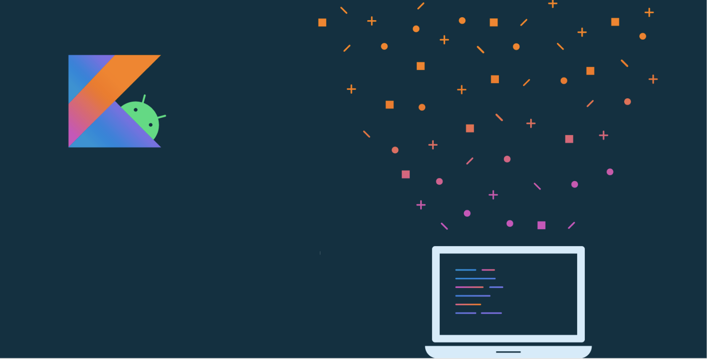
Lesson 6:
App navigation

Slide 2
About this lesson
Lesson 6: App navigation
Multiple activities and intents
App bar, navigation drawer, and menus
Fragments
Navigation in an app
More custom navigation behavior
Navigation UI
Summary

Slide 3
Multiple activities and intents

Slide 4
Multiple screens in an app
Sometimes app functionality may be separated into multiple screens.
Examples:
View details of a single item (for example, product in a shopping app)
Create a new item (for example, new email)
Show settings for an app
Access services in other apps (for example, photo gallery or browse documents)
Notes:
So far we’ve looked at Android apps that have a single screen that is implemented as a single Activity. As you add more functionality to your app, it may make sense to separate the features into different screens within your app. One way to have different screens in your app is to implement them as individual Activities that each have a specific purpose (as shown by the examples mentioned above). This can make your code easier to maintain and reuse.
Resource:
Introduction to Activities

Slide 5
Intent
Requests an action from another app component, such as another Activity
An Intent usually has two primary pieces of information:
Action to be performed (for example, ACTION_VIEW, ACTION_EDIT, ACTION_MAIN)
Data to operate on (for example, a person’s record in the contacts database)
Commonly used to specify a request to transition to another Activity
Notes:
Android uses a construct called an Intent to request an action from another component. For example, an Intent can specify a request to transition to another Activity.
Although our discussion of Intents will focus on navigating between Activities, they can do much more. For example, an Intent could contain data for the destination Activity to use, such as details about an item to be displayed. Data can also be passed back to the source Activity.
Resources:
Intents and Intent Filters
Intent Structure

Slide 6
Explicit intent
Fulfills a request using a specific component
Navigates internally to an Activity in your app
Navigates to a specific third-party app or another app you've written
Notes:
There are two primary types of Intents: explicit and implicit Intents. Explicit intents are the most strict, indicating a specific component that should handle the request. Explicit intents are commonly used when navigating between components within your app, and you know what the class name is. You can also use them to navigate to a known third-party app if you are absolutely sure what type of Intent they can handle.

Slide 7
Explicit intent examples
Navigate between activities in your app:
fun viewNoteDetail() {
val intent = Intent(this, NoteDetailActivity::class.java)
intent.putExtra(NOTE_ID, note.id)
startActivity(intent)
}
Navigate to a specific external app:
fun openExternalApp() {
val intent = Intent("com.example.workapp.FILE_OPEN")
if (intent.resolveActivity(packageManager) != null) {
startActivity(intent)
}
}
Notes:
Transition: 1 click
We have two explicit Intent examples above: one where the destination activity is contained within our own app, and a second intent that navigates to an external app. Notice that in the second example we first check that we can resolve the Intent; that is, is there an app on the device that can handle this Intent? If so, then we can safely call startActivity() with that Intent.
Intent Extras give us a means to pass data to the activity that will handle our request.
Resource:
Example Explicit Intent

Slide 8
Implicit intent
Provides generic action the app can perform
Resolved using mapping of the data type and action to known components
Allows any app that matches the criteria to handle the request
Notes:
Implicit intents on the other hand don’t specify an intended target, and instead provide just enough information for the system to resolve which component should handle the intent. For components that your app doesn’t own, this is the recommended type of intent. If multiple apps can handle the intent, the system launches the default app or lets the user select one.
Unlike explicit intents, implicit intents don't depend on a specific component being available.
Resources:
Intent
Common Intents

Slide 9
Implicit intent example
fun sendEmail() {
val intent = Intent(Intent.ACTION_SEND)
intent.type = "text/plain"
intent.putExtra(Intent.EXTRA_EMAIL, emailAddresses)
intent.putExtra(Intent.EXTRA_TEXT, "How are you?")
if (intent.resolveActivity(packageManager) != null) {
startActivity(intent)
}
}
Notes:
Here’s an example of creating an implicit intent to send an email on the device. We don’t mind which email app handles the request, as long as it's able to send the email for us.
Resource:
Email Intent

Slide 10
Register your app to handle intent
Define intent filter in your Android manifest
Adding code in onCreate to work with extra data if has

Slide 11
App bar, navigation drawer, and menus
Notes:
Let’s briefly discuss some of the common UI elements you’ll use to navigate your apps.

Slide 12
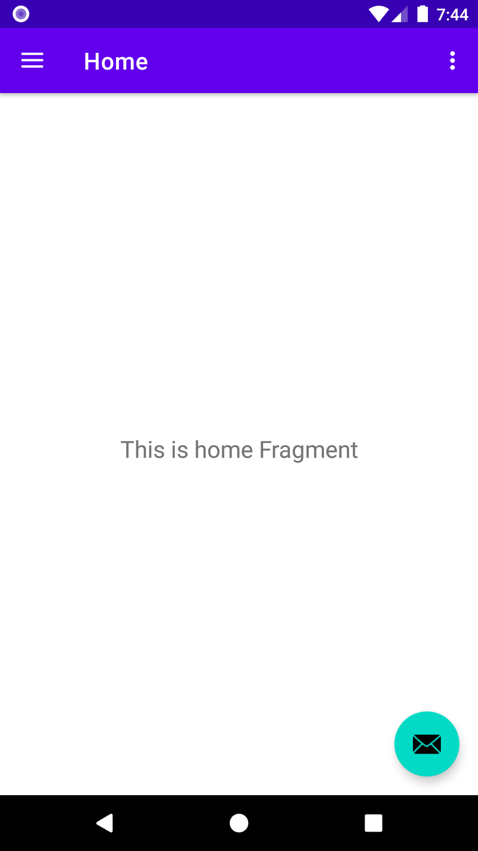
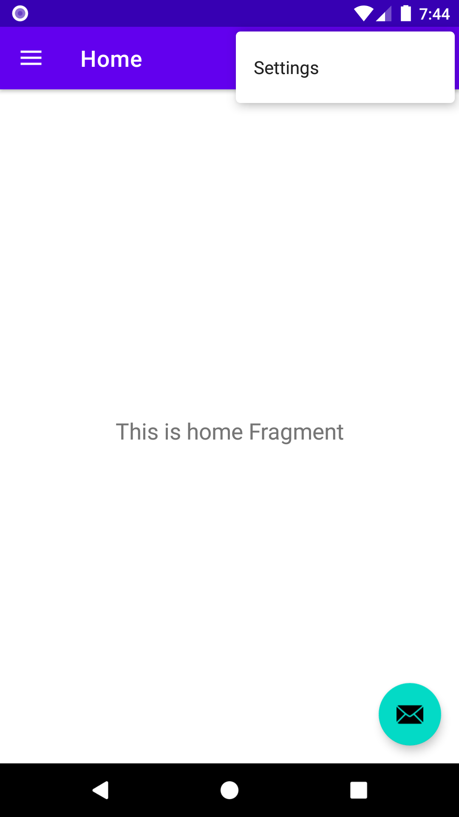
App bar
Notes:
At the top of the screen is the App Bar. It displays the name of your Activity or app. It provides the user with access to important actions in a predictable way, such as the overflow menu (represented by the 3 vertical dots) which displays additional menu options. It also has support for navigation (navigation drawer) or view switching (with tabs or drop-down lists).
Resource:
App bar

Slide 13
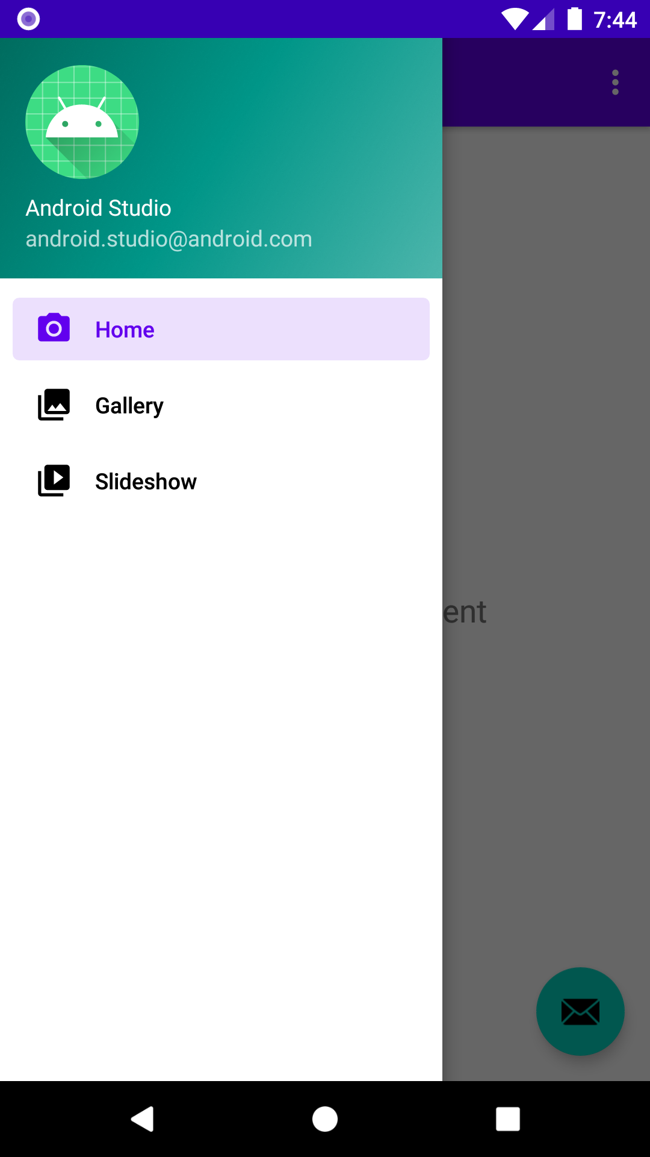
Navigation drawer
Notes:
The navigation drawer is an element that's often seen in apps. Open the drawer by tapping the hamburger icon (the three horizontal lines), or with a swipe in gesture from the left side of the screen. The navigation drawer lets you quickly navigate to locations in your app. The options menu and the navigation drawer both use menus behind the scenes.
Resources:
Use action views and action providers
Navigation Drawer Usage

Slide 14
Menu
Define menu items in XML menu resource (located in res/menu folder)
<menu xmlns:android="http://schemas.android.com/apk/res/android"
xmlns:app="http://schemas.android.com/apk/res-auto">
<item
android:id="@+id/action_settings"
android:orderInCategory="100"
android:title="@string/action_settings"
app:showAsAction="never" />
</menu>
Notes:
There are different types of menus provided by the framework: options menus, context menus, and popup menus. Menu resources are located in the res/menu directory, and are defined with a menu tag. In your menu XML file, you can set the string resources that this menu item uses as a title, an id, and several other options like ordering or icons.
Resource:
Menus

Slide 15
More menu options
<menu>
<group android:checkableBehavior="single">
<item
android:id="@+id/nav_home"
android:icon="@drawable/ic_menu_camera"
android:title="@string/menu_home" />
<item
android:id="@+id/nav_gallery"
android:icon="@drawable/ic_menu_gallery"
android:title="@string/menu_gallery" />
<item
android:id="@+id/nav_slideshow"
android:icon="@drawable/ic_menu_slideshow"
android:title="@string/menu_slideshow" />
</group>
</menu>
Notes:
Here is the XML for a navigation drawer. It demonstrates the use of icons and groups. We won’t use the navigation drawer until later in the lesson, but its underlying representation as a menu is useful to mention briefly now.

Slide 16
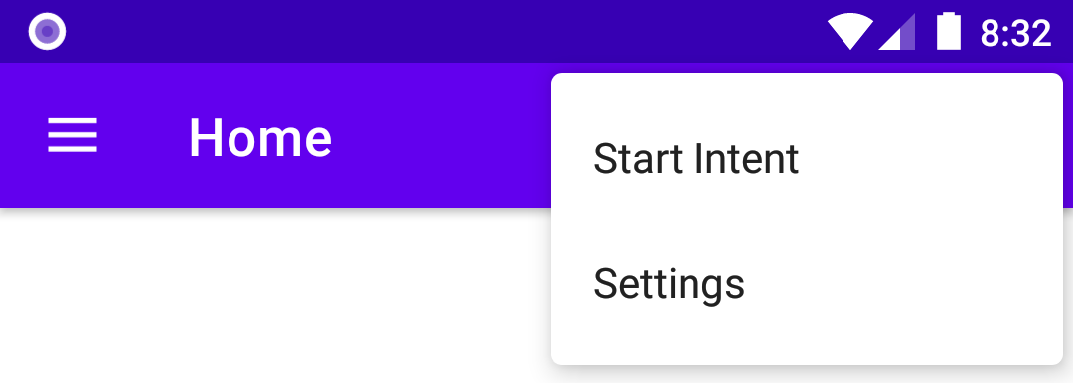
Options menu example
<menu xmlns:android="http://schemas.android.com/apk/res/android"
xmlns:app="http://schemas.android.com/apk/res-auto">
<item android:id="@+id/action_intent"
android:title="@string/action_intent" />
<item
android:id="@+id/action_settings"
android:orderInCategory="100"
android:title="@string/action_settings"
app:showAsAction="never" />
</menu>
Notes:
Transition: 1 click
Let’s look at an options menu example in an Activity. Add a menu item by creating a new item tag and giving it an ID and title. We now have a new menu item that does nothing when we click it.

Slide 17
Inflate options menu
override fun onCreateOptionsMenu(menu: Menu): Boolean {
menuInflater.inflate(R.menu.main, menu)
return true
}
Notes:
To inflate the menu, we need to override onCreateOptionsMenu() within the Activity. Once you add this code, the menu options will show in the app bar. Some of the default project templates come with onCreateOptionsMenu() already implemented.
Resource:
Create Options Menu

Slide 18
Handle menu options selected
override fun onOptionsItemSelected(item: MenuItem): Boolean {
when (item.itemId) {
R.id.action_intent -> {
val intent = Intent(Intent.ACTION_WEB_SEARCH)
intent.putExtra(SearchManager.QUERY, "pizza")
if (intent.resolveActivity(packageManager) != null) {
startActivity(intent)
}
}
else -> Toast.makeText(this, item.title, Toast.LENGTH_LONG).show()
...
Notes:
To respond to the user selecting a menu item, override onOptionsItemSelected() within the Activity as shown in the example. Now our menu will conditionally launch a web search Intent for pizza, or show a toast message depending on the menu item.
Resource:
Create Options Menu
Add and handle actions

Slide 19
Fragments
Notes:
As we navigate to different screens in our app, we can use different activities. Or we can use fragments.

Slide 20
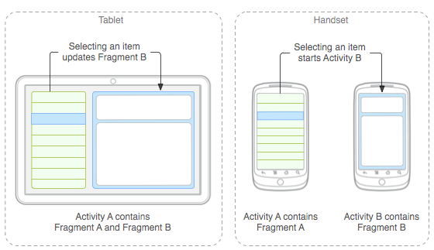
Fragments for tablet layouts
Notes:
Fragments were first introduced into the Android platform in Android 3.0 (the Honeycomb release), when support for tablets was added. An Activity that displayed a list of items would look silly if the list items took up the entire width of the screen on a tablet. Hence, the need for fragments arose. With the introduction of fragments, on a tablet device, an activity could display a list fragment on the left, and a detail fragment on the right. On a phone device, an activity could display one fragment at a time because of the smaller screen real estate available.
It turns out that breaking up the structure of your UI into fragments is useful in other contexts besides building for tablets. Fragments are a core concept to understand when building apps in Android.

Slide 21
Fragment
Represents a behavior or portion of the UI in an activity ("microactivity")
Must be hosted in an activity
Lifecycle tied to host activity's lifecycle
Can be added or removed at runtime
Notes:
More formally, a fragment represents a behavior or a portion of the UI in an Activity. You can think of it as a "micro activity". You can display multiple fragments in a single activity (as in the tablet case), or reuse a fragment in multiple activities. You can think of a fragment as a modular section of an activity that has its own lifecycle, receives its own input events, and which you can add or remove while the activity is running.
Resources:
Fragments: Past, Present, and Future (Android Dev Summit '19)
Fragments

Slide 22
Note about fragments
Use the AndroidX version of the Fragment class. (androidx.fragment.app.Fragment).
Don't use the platform version of the Fragment class (android.app.Fragment), which was deprecated.
Notes:
When using the Fragment class, be sure you use the version provided in the androidx package, rather than the Fragment class provided in the platform (which originated in API level 11 and was deprecated in API level 28).
Resource:
Fragment

Slide 23
Navigation within an app
Notes:
As you add more fragments to your app, you will want to consider how to navigate between them.

Slide 24
Navigation component
Collection of libraries and tooling, including an integrated editor, for creating navigation paths through an app
Assumes one Activity per graph with many Fragment destinations
Consists of three major parts:
Navigation graph
Navigation Host (NavHost)
Navigation Controller (NavController)
Notes:
The navigation component is a collection of libraries, tooling, and IDE integrations for creating navigation paths through an app. It works best with the paradigm of "one activity, many fragments" over having many activities. It’s composed of three parts that work together analogous to how you might experience watching television or listening to the radio.
The Navigation Graph represents a set of destination fragments or activities your app is able to display. In our TV analogy, this would be a list of available programs to watch.
The Navigation Host is the container that displays the destinations listed in your navigation graph, like a TV or monitor screen.
The Navigation Controller is the means of navigating between different destinations. In our TV analogy, this would be the equivalent of a TV remote with which to switch to different programs or channels.
Fragments can link to other fragments, creating a full graph of destinations, while Activities can only be a terminal destination for the graph, meaning that they are always an endpoint on the graph. (Each activity can have its own navigation graph, but this provides less benefit than having all of the destinations in a single graph.)

Slide 25
Add dependencies
In build.gradle, under dependencies:
implementation "androidx.navigation:navigation-fragment-ktx:$nav_version"
implementation "androidx.navigation:navigation-ui-ktx:$nav_version"
Notes:
To begin working with the Navigation component, we need to add some dependencies to the build.gradle file. For the nav_version, look at the Navigation library release notes page for the current stable release.
Resources:
Navigation
Set up your environment

Slide 26
Navigation host (NavHost)
<fragment
android:id="@+id/nav_host"
android:name="androidx.navigation.fragment.NavHostFragment"
android:layout_width="match_parent"
android:layout_height="match_parent"
app:defaultNavHost="true"
app:navGraph="@navigation/nav_graph_name"/>
Notes:
Let’s start with our navigation host, which is an empty container where destinations are swapped in and out as a user navigates through your app. A navigation host must implement the NavHost interface. The default NavHost implementation, NavHostFragment, handles swapping fragment destinations for you, so let’s use that.
Use the fragment XML tag to declare the NavHostFragment within the activity XML layout. This NavHostFragment must be declared within the Activity that will house all the Fragments we’ll be switching between. Note a couple of important attributes that we’ll be revisiting later.
android:name attribute has a value that is the fully qualified class name of our fragment
app:defaultNavHost is set to true to ensure that this navigation host will intercept the system's Back button taps
app:navGraph points to the navigation graph listing all of our fragment destinations
Resource:
Add a NavHost to an activity

Slide 27
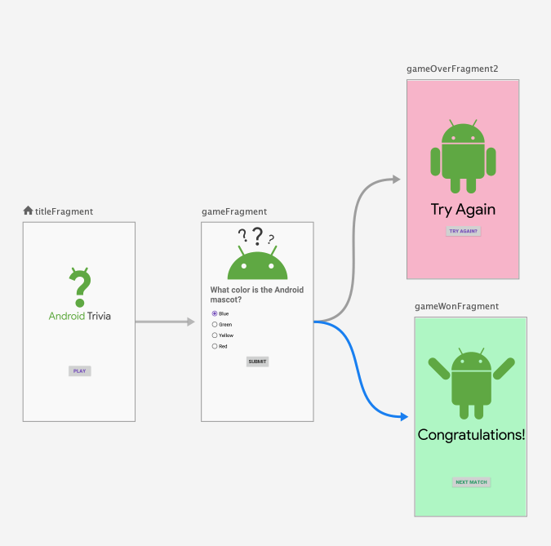
Navigation graph
New resource type located in res/navigation directory
XML file containing all of your navigation destinations and actions
Lists all the (Fragment/Activity) destinations that can be navigated to
Lists the associated actions to traverse between them
Optionally lists animations for entering or exiting
Notes:
You will be creating a navigation graph, which is a resource file that contains all your destinations and the actions to navigate between them. It represents all the possible navigation paths within your Activity. This example shows a visual representation of a navigation graph for a sample app with destinations and the actions that connect them (represented by arrows).

Slide 28
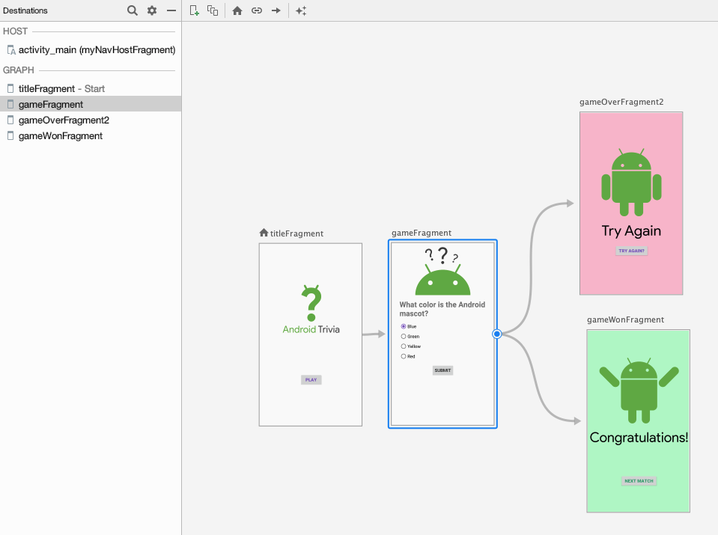
Navigation Editor in Android Studio
Notes:
In Android Studio, the Design view of the navigation graph resource file shows you a visual representation of the connections between different destinations for your Activity. This is called the Navigation Editor in Android Studio. You can link destinations (the arrow button) and set entry points (the home button) from this interface.

Slide 29
Creating a Fragment
Extend Fragment class
Override onCreateView()
Inflate a layout for the Fragment that you have defined in XML
class DetailFragment : Fragment() {
override fun onCreateView(inflater: LayoutInflater, container: ViewGroup?,
savedInstanceState: Bundle?): View? {
return inflater.inflate(R.layout.detail_fragment, container, false)
}
}
Notes:
Transition: 1 click
Let’s talk about fragment destinations next. To create a fragment, extend the Fragment class. In an Activity, we would override the onCreate() method, but within a fragment’s onCreate() method, it isn’t guaranteed that any of the host activity’s view hierarchy is initialized. Instead, layout inflation is done in the fragment’s onCreateView() method. We recommended only inflating views in onCreateView().
Resources:
Fragment
Fragments Guide

Slide 30
Specifying Fragment destinations
Fragment destinations are denoted by the action tag in the navigation graph.
Actions can be defined in XML directly or in the Navigation Editor by dragging from source to destination.
Autogenerated action IDs take the form of action_<sourceFragment>_to_<destinationFragment>.
Notes:
Actions can be defined in XML directly, or using the Navigation Editor. From the Navigation Editor's navigation graph UI, specify destination paths by dragging from a source fragment to a destination fragment. This automatically gives the action an ID in the form action_<sourceFragment>_to_<destinationFragment>. You can subsequently rename the action ID using a shorter name.

Slide 31
Example fragment destination
<fragment
android:id="@+id/welcomeFragment"
android:name="com.example.android.navigation.WelcomeFragment"
android:label="fragment_welcome"
tools:layout="@layout/fragment_welcome" >
<action
android:id="@+id/action_welcomeFragment_to_detailFragment"
app:destination="@id/detailFragment" />
</fragment>
Notes:
This snippet shows how you can specify fragment destinations directly in XML.

Slide 32
Navigation Controller (NavController)
NavController manages UI navigation in a navigation host.
Specifying a destination path only names the action, but it doesn’t execute it.
To follow a path, use NavController.
Notes:
After naming all your paths, to actually navigate to them, you need to use the NavController when the button or link in your UI is selected.
Resource:
Navigate to a destination

Slide 33
Example NavController
class MainActivity : AppCompatActivity() {
override fun onCreate(savedInstanceState: Bundle?) {
...
val navController = findNavController(R.id.myNavHostFragment)
}
fun navigateToDetail() {
navController.navigate(R.id.action_welcomeFragment_to_detailFragment)
}
}
Notes:
In your Activity, your NavController will be tied to the navigation host. navigate will navigate to a destination fragment with no arguments.

Slide 34
More custom navigation behavior

Slide 35
Passing data between destinations
Using Safe Args:
Ensures arguments have a valid type
Lets you provide default values
Generates a <SourceDestination>Directions class with methods for every action in that destination
Generates a class to set arguments for every named action
Generates a <TargetDestination>Args class providing access to the destination's arguments
Notes:
In many cases, your destination fragment will need some data to construct itself. The Navigation component has a Gradle plugin called Safe Args that generates simple object and builder classes for type-safe navigation, and access to any associated arguments. Safe Args is strongly recommended when navigating and passing data between destinations to ensure type-safety.

Slide 36
Setting up Safe Args
In the project build.gradle file:
buildscript {
repositories {
google()
}
dependencies {
classpath "androidx.navigation:navigation-safe-args-gradle-plugin:$nav_version"
}
}
In the app's or module's build.gradle file:
apply plugin: "androidx.navigation.safeargs.kotlin"
Notes:
Transition: 1 click
To get started with Safe Args, you will need to edit two of your Gradle files. First, edit the top level build.grade file to add a classpath dependency for the Safe Args plugin. Next, add a line in your app or module's build.gradle file to apply the plugin.
Resource:
Use Safe Args to pass data with type safety

Slide 37
Sending data to a Fragment
Create arguments the destination fragment will expect.
Create action to link from source to destination.
Set the arguments in the action method on <Source>FragmentDirections.
Navigate according to that action using the Navigation Controller.
Retrieve the arguments in the destination fragment.
Notes:
After setting up the Gradle dependencies and plugins for Safe Args, here are the steps you must complete to send data between fragments. As a concrete example, the next few slides refer to an app that takes in two numbers on one fragment, and then sends them to the next fragment to be multiplied together.
Resource:
Pass data between destinations

Slide 38
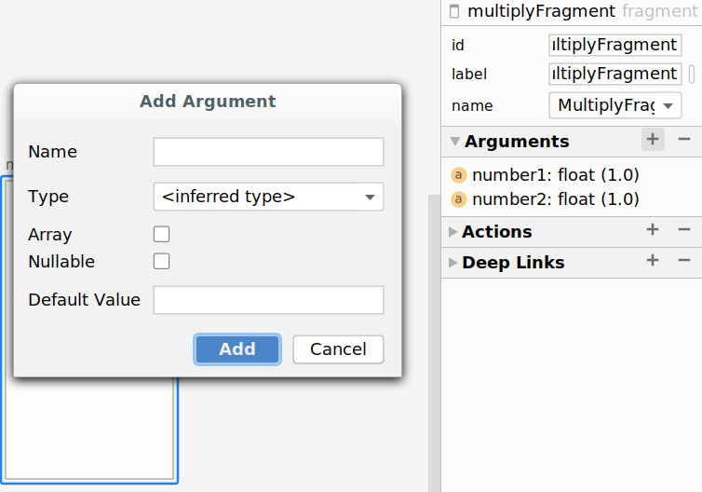
Destination arguments
<fragment
android:id="@+id/multiplyFragment"
android:name="com.example.arithmetic.MultiplyFragment"
android:label="MultiplyFragment" >
<argument
android:name="number1"
app:argType="float"
android:defaultValue="1.0" />
<argument
android:name="number2"
app:argType="float"
android:defaultValue="1.0" />
</fragment>
Notes:
Define arguments on the destination fragment that will receive them. Android Studio provides a helpful way to create arguments for a fragment within the Navigation Editor. It creates the XML code in our navigation graph for us. In this example, we have set two arguments (of type Float) that MultiplyFragment expects to receive.
Resources:
Define destination arguments

Slide 39
Supported argument types
Type | Type Syntax app:argType=<type> | Supports Default Values | Supports Null Values
Integer | "integer" | Yes | No
Float | "float" | Yes | No
Long | "long" | Yes | No
Boolean | "boolean" | Yes ("true" or "false") | No
String | "string" | Yes | Yes
Array | above type + "[]" (for example, "string[]" "long[]") | Yes (only "@null") | Yes
Enum | Fully qualified name of the enum | Yes | No
Resource reference | "reference" | Yes | No
Notes:
You aren’t just limited to floats, as in the example code. You can pass most types as arguments in a fragment. Primitive types like numbers, booleans, and strings require their lowercase name as the argument type. You are also able to pass an array of those types. Enum classes require the fully qualified name and resources from the res/ directory require “reference” as the argument type.
Resource:
Supported argument types

Slide 40
Supported argument types: Custom classes
Type | Type Syntax app:argType=<type> | Supports Default Values | Supports Null Values
Serializable | Fully qualified class name | Yes (only "@null") | Yes
Parcelable | Fully qualified class name | Yes (only "@null") | Yes
Notes:
We haven’t talked much in this course about Serializable or Parcelable, but we'll include them for completion’s sake. Serialization is the process of taking an object’s state and converting it into a stream of data for transmission. Serializable is the interface you would implement for a pure JVM class. Parcelable does serialization as well, but in a way that’s more optimized for Android. With either, the intent system we learned about earlier and in the Navigation component, you will need to use one or the other to pass custom classes as arguments.
Resources:
Serializable
Parcelable
Supported argument types

Slide 41
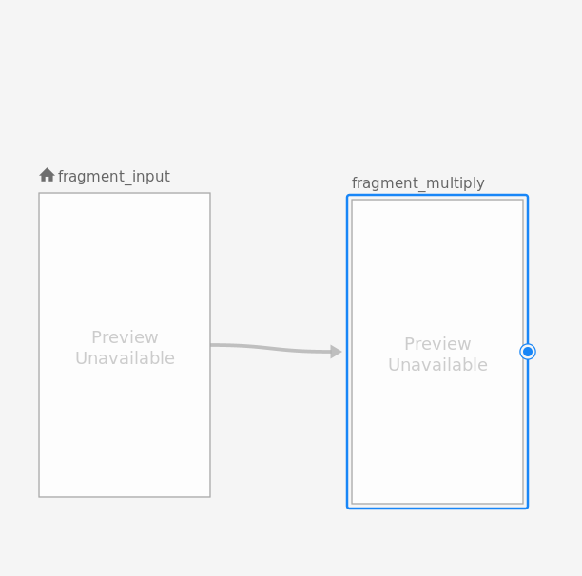
Create action from source to destination
In nav_graph.xml:
<fragment
android:id="@+id/fragment_input"
android:name="com.example.arithmetic.InputFragment">
<action
android:id="@+id/action_to_multiplyFragment"
app:destination="@id/multiplyFragment" />
</fragment>
Notes:
Let’s look at a more complete example. In our navigation graph, we’ve created an action from the InputFragment to the MultiplyFragment.

Slide 42
Navigating with actions
In InputFragment.kt:
override fun onViewCreated(view: View, savedInstanceState: Bundle?) {
super.onViewCreated(view, savedInstanceState)
binding.button.setOnClickListener {
val n1 = binding.number1.text.toString().toFloatOrNull() ?: 0.0
val n2 = binding.number2.text.toString().toFloatOrNull() ?: 0.0
val action = InputFragmentDirections.actionToMultiplyFragment(n1, n2)
view.findNavController().navigate(action)
}
}
Notes:
In the onClickListener of our source fragment, we call the action function on the Directions class (called InputFragmentDirections), both of which were created for us. Because the target destination (MultiplyFragment) requires two arguments, the action class for that transition also has two arguments. After assembling those, we can call navigate() on the NavController.
In this example, we are using data binding for our fragments. It’s also important to note that while you can put the setOnClickListener inside onCreateView, putting it inside onViewCreated removes the safety (?.) checks you would have to do.

Slide 43
Retrieving Fragment arguments
class MultiplyFragment : Fragment() {
val args: MultiplyFragmentArgs by navArgs()
lateinit var binding: FragmentMultiplyBinding
override fun onViewCreated(view: View, savedInstanceState: Bundle?) {
super.onViewCreated(view, savedInstanceState)
val number1 = args.number1
val number2 = args.number2
val result = number1 * number2
binding.output.text = "${number1} * ${number2} = ${result}"
}
}
Notes:
Finally, we are able to retrieve our arguments. MultiplyFragmentArgs is another generated class based on our navigation graph. navArgs comes from androidx.navigation.fragment.navArgs. After the fragment’s view is created, we can access and use the arguments. In this case, we update a TextView with the product of the two numbers.

Slide 44
Navigation UI
Notes:
NavigationUI is a class that works to connect elements like the navigation drawer, bottom navigation bar, and menus to your Navigation Controller.

Slide 45
Menus revisited
override fun onOptionsItemSelected(item: MenuItem): Boolean {
val navController = findNavController(R.id.nav_host_fragment)
return item.onNavDestinationSelected(navController) ||
super.onOptionsItemSelected(item)
}
Notes:
Earlier in the lesson, we learned how to navigate between Activities using intents. Now that we have the Navigation Component set up, let’s replace that functionality to use the NavigationUI class. If the menu item id is the same as an action or destination id, NavigationUI will route to the proper place. This frees us from having to handle each menu item separately.
Resources:
onNavDestinationSelected

Slide 46
DrawerLayout for navigation drawer
<androidx.drawerlayout.widget.DrawerLayout
android:id="@+id/drawer_layout" ...>
<fragment
android:name="androidx.navigation.fragment.NavHostFragment"
android:id="@+id/nav_host_fragment" ... />
<com.google.android.material.navigation.NavigationView
android:id="@+id/nav_view"
app:menu="@menu/activity_main_drawer" ... />
</androidx.drawerlayout.widget.DrawerLayout>
Notes:
Using a navigation drawer requires a bit of setup, in addition to the menu XML for the navigation drawer that we saw earlier. In the layout XML file for your activity, declare a DrawerLayout as the root view. Within the DrawerLayout, add a layout for the main UI content (which is NavHostFragment in this case), and another view for the contents of the navigation drawer (which is the NavigationView). Notice that the NavigationView app:menu attribute points to the activity_main_drawer menu XML resource, which is where the menu items for our navigation drawer are defined.
Resources:
Add a navigation drawer
Navigation Views

Slide 47
Finish setting up navigation drawer
Connect DrawerLayout to navigation graph:
val appBarConfiguration = AppBarConfig(navController.graph, drawer)
Set up NavigationView for use with a NavController:
val navView = findViewById<NavigationView>(R.id.nav_view)
navView.setupWithNavController(navController)
Notes:
Transition: 1 click
Within your Activity code, connect the DrawerLayout to the navigation graph. Then set up the NavigationView with the NavController. This will call MenuItem.onNavDestinationSelected when a menu item is selected. The selected item in the NavigationView will automatically be updated when the destination changes.
Resource:
Add a navigation drawer

Slide 48
Understanding the back stack
State 1
State 2
State 3
Activity 3
Activity 2
Activity 2
Activity 2
Activity 1
Activity 1
Activity 1
Back stack
Back stack
Back stack
Notes:
Transitions: 3 clicks
Let’s talk about another concept that you’ll encounter as you deal with app navigation: the back stack. Within your app, Android keeps track of the activities you’ve opened as a collection of activities in a stack, known as the back stack.
When your app first launches, the first activity gets added onto the back stack. As you traverse through an app, Android has a "last in, first out" approach for keeping track of the activities you’ve visited. Android adds the most recent Activity you just started on top of the stack.
State 1: A new Activity (Activity 2) is started and added to the top of the stack. Activity 2 now has the focus and the user can interact with it.
State 2: When you start another (Activity 3), it gets added to the top of the stack. Activity 2 is stopped, and Activity 3 now has the focus.
State 3: When you tap the Back button, Android pops Activity 3 off the stack and finishes it. Activity 2 is now on top of the stack and gets resumed.
Resource:
Understand Tasks and Back Stack

Slide 49
Fragments and the back stack
State 1
State 2
State 3
Activity 2
Fragment 2
Activity 2
Activity 2
Fragment 1
Fragment 1
Fragment 1
Activity 1
Activity 1
Activity 1
Back stack
Back stack
Back stack
Notes:
Transitions: 3 clicks
Conveniently, when using fragments with the Navigation component, there is also a back stack of fragments that gets maintained as we traverse through different fragments in our app. In this example:
State 1: We start with Activity 2 displaying Fragment 1. (Activity 1 is currently stopped and in the background.)
State 2: Then within Activity 2, we navigate to another Fragment (Fragment 2), which gets adds to the top of the back stack within its host Activity.
State 3: When you tap the Back button, Fragment 2 is popped off the back stack and Fragment 1 would become the active Fragment again.
Note that although Fragments have their own lifecycle within the host Activity, their lifecycle is directly tied to that of the Activity.
We'll talk about the Activity and Fragment lifecycles and the back stack in more detail in the next lesson.

Slide 50
Summary

Slide 51
Summary
In Lesson 6, you learned how to:
Use explicit and implicit intents to navigate between Activities
Structure apps using fragments instead of putting all UI code in the Activity
Handle navigation with NavGraph, NavHost, and NavController
Use Safe Args to pass data between fragment destinations
Use NavigationUI to hook up top app bar, navigation drawer, and bottom navigation
Android keeps a back stack of all the destinations you’ve visited, with each new destination being pushed onto the stack.

Slide 52
Learn more
Principles of navigation
Navigation component
Pass data between destinations
NavigationUI

Slide 53

Pathway
Practice what you’ve learned by completing the pathway:
Lesson 6: App navigation

